Slide 1

Project U_CAN
Graphics and Visual Identity
WM Studio

Slide 2
Variant Analysis
03
Variant 3
Concretization combining various elements

Slide 3

01
Concretization combining various elements
Variant 3

Slide 4

01
Black / White
Variant 3

Slide 5
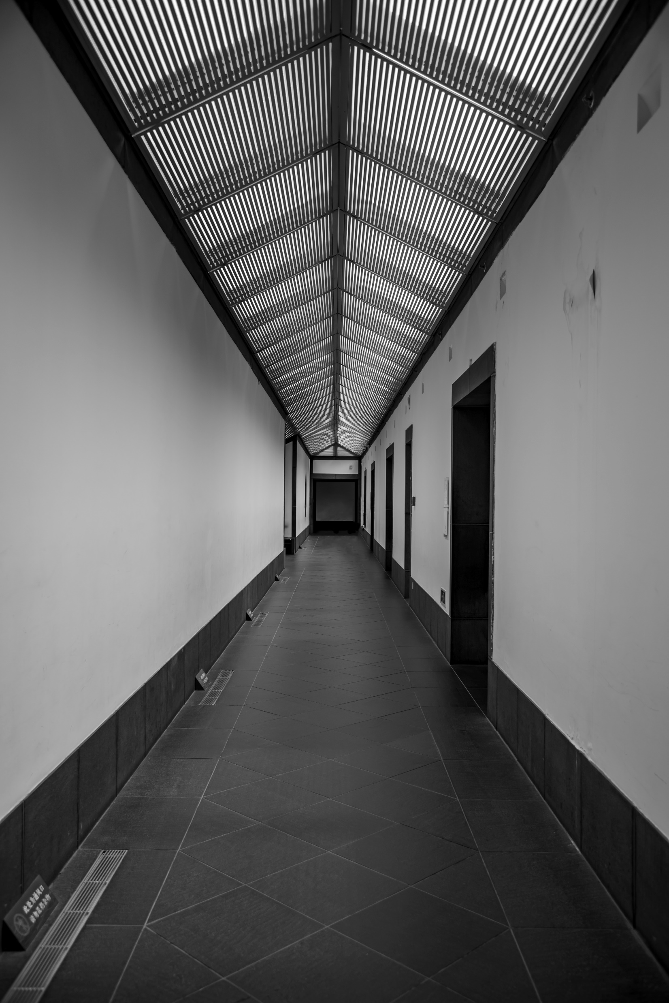

Slide 6
THANKS FOR WATCHING

